Slide 1

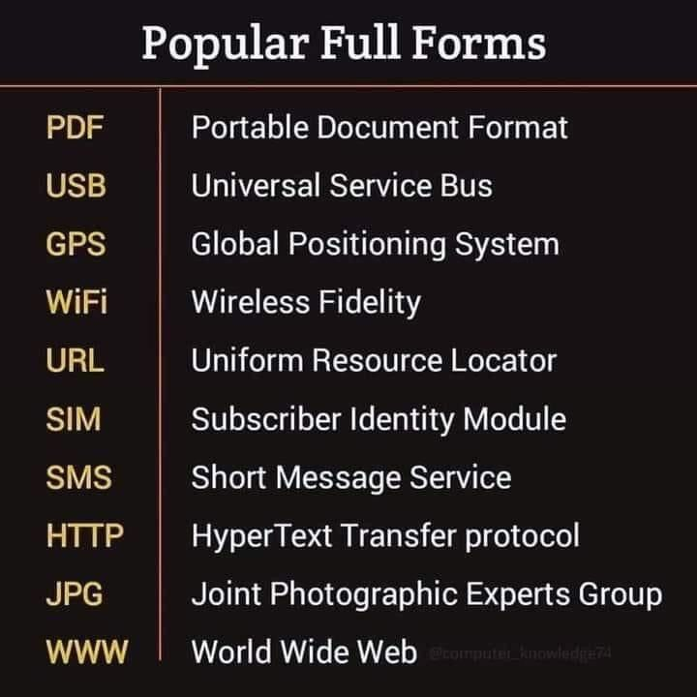
Mic Soft solutions
COURESE

Slide 2

C- Basic , HW-basic

Slide 3
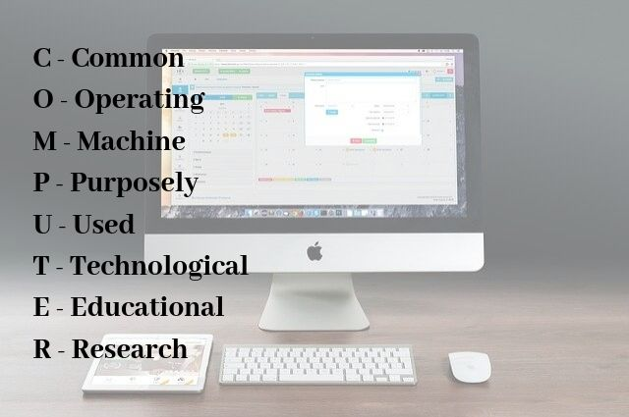
CCC sc-basic, Adv, Excel tally,DTP,

Slide 4


Slide 5


Slide 6


